Slide 1


CST 205 OOP

Slide 2
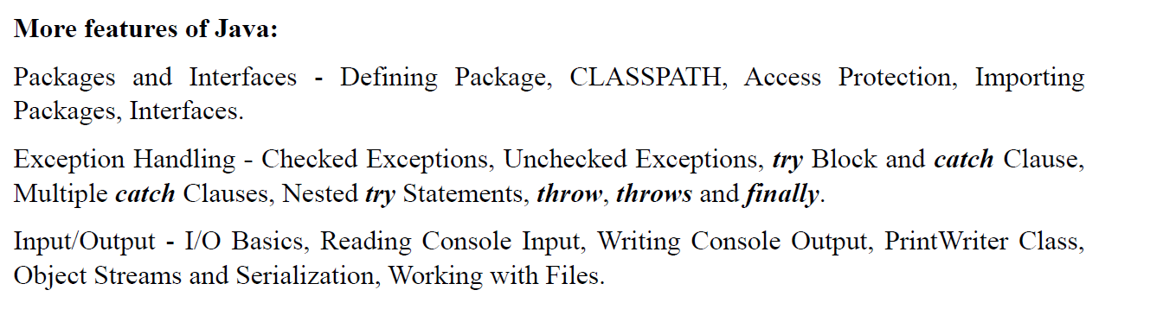
SYLLABUS

Slide 3
OBJECTIVE
INTRODUCTION TO PACKAGES.
ACCESS CONTROL MECHANISM
IMPORTING PACKAGES
ADVANTAGES OF PACKAGES
TYPES OF PACKAGES
BASICS OF EXCEPTION HANDLING
TYPES OF EXCEPTION

Slide 4
Introduction to packages
In small projects, all the java files have unique names. So, it is not difficult to put them in a single folder.
But, in the case of huge projects where the number of java files is large, it is very difficult to put files in a single folder because the manner of storing files would be disorganized.
Moreover, if different java files in various modules of the project have the same name, it is not possible to store two java files with the same name in the same folder because it may occur naming conflict.
This problem of naming conflict can be overcome by using the concept of packages.

Slide 5
In Java, APIs consist of one or more packages where packages consist of many classes, classes contain several methods and fields.
When you create an application in Java, you should create a proper folder structure for better reusability, maintenance, and avoiding naming conflict

Slide 6
PACKAGES
Packages are containers for classes that are used to keep the class name space compartmentalized.
For example, a package allows you to create a class named List,which you can store in your own package without concern that it will collide with some other class named List stored elsewhere.
Packages are stored in a hierarchical manner and are explicitly imported into new class definitions.
In the preceding chapters, the name of each example class was taken from the same name space.
This means that a unique name had to be used for each class to avoid name collisions.

Slide 7
PACKAGES
After a while, without some way to manage the name space, you could run out of convenient, descriptive names for individual classes.
The name you choose for a class SHOULD be reasonably unique and not collide with class names chosen by other programmers.
Java provides a mechanism for partitioning the class name space into more manageable chunks. This mechanism is the package.
The package is both a naming and a visibility control mechanism.
You can define classes inside a package that are not accessible by code outside that package.
You can also define class members that are only exposed to other members of the same package.

Slide 8
Defining a Package
To create a package is quite easy: simply include a package command as the first statement in a Java source file.
Any classes declared within that file will belong to the specified package.
The package statement defines a name space in which classes are stored.
If you omit the package statement, the class names are put into the default package, which has no name.
This is the general form of the package statement:
package pkg;
Here, pkg is the name of the package. For example, the following statement creates a package
called MyPackage.
package MyPackage;

Slide 9
Defining a Package
Java uses file system directories to store packages. For example, the .class files for any classes you declare to be part of MyPackage must be stored in a directory called MyPackage
You can create a hierarchy of packages.
The general form of a multileveled package statement is shown here:
package pkg1[.pkg2[.pkg3]];
A package hierarchy must be reflected in the file system of your Java development system.
For example, a package declared as
package java.awt.image;needs to be stored in java\awt\image in a Windows environment.

Slide 10
Finding Packages and CLASSPATH
First, by default, the Java run-time system uses the current working directory as its starting point. Thus, if your package is in a subdirectory of the current directory, it will be found.
Second, you can specify a directory path or paths by setting the CLASSPATH environmental variable.
Third, you can use the -classpath option with java and javac to specify the path to your classes.
For example, consider the following package specification:
package MyPack
For example, in a Windows environment, if the path to MyPack is
C:\MyPrograms\Java\MyPack
Then the class path to MyPack is
C:\MyPrograms\Java

Slide 11
A Short Package Example
// A simple package
package MyPack;
class Balance {
String name;
double bal;
Balance(String n, double b) {
name = n;
bal = b;
}
void show() {
if(bal<0)
System.out.print("--> ");
System.out.println(name + ": $" + bal);
}
}

Slide 12
A Short Package Example
// A simple package
class AccountBalance {
public static void main(String args[]) {
Balance current[] = new Balance[3];
current[0] = new Balance("K. J. Fielding", 123.23);
current[1] = new Balance("Will Tell", 157.02);
current[2] = new Balance("Tom Jackson", -12.33);
for(int i=0; i<3; i++)
{
current[i].show();
}}
}

Slide 13
Defining a Package
Call this file AccountBalance.java and put it in a directory called MyPack.
Next, compile the file. Make sure that the resulting .class file is also in the MyPack directory.
Then, try executing the AccountBalance class, using the following command line:
java MyPack.AccountBalance
Remember, you will need to be in the directory above MyPack when you execute this command.
As explained, AccountBalance is now part of the package MyPack. This means that it cannot be executed by itself. That is, you cannot use this command line:
java AccountBalance
AccountBalance must be qualified with its package name.

Slide 14
Access Protection
Classes and packages are both means of encapsulating and containing the name space and scope of variables and methods.
Packages act as containers for classes and other subordinate packages. Classes act as containers for data and code.
The class is Java’s smallest unit of abstraction.
Because of the interplay between classes and packages, Java addresses four categories of visibility for class members:
• Subclasses in the same package
• Non-subclasses in the same package
• Subclasses in different packages
• Classes that are neither in the same package nor subclasses

Slide 15
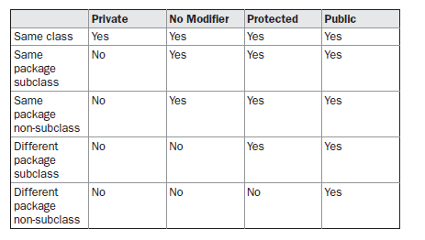
Access Protection

Slide 16
Access Protection
A non-nested class has only two possible access levels: default and public.
When a class is declared as public, it is accessible by any other code.
If a class has default access, then it can only be accessed by other code within its same package.
When a class is public, it must be the only public class declared in the file,and the file must have the same name as the class.

Slide 17
An Access Example
package p1; public class Protection { int n = 1;//default access private int n_pri = 2; protected int n_pro = 3; public int n_pub = 4; public Protection() { | System.out.println("base constructor"); System.out.println("n = " + n); System.out.println("n_pri = " + n_pri); System.out.println("n_pro = " + n_pro); System.out.println("n_pub = " + n_pub); } }

Slide 18
This is file Derived.java:
package p1;
class Derived extends Protection {
Derived() {
System.out.println("derived constructor");
System.out.println("n = " + n);
// class only
// System.out.println("n_pri = "4 + n_pri);
System.out.println("n_pro = " + n_pro);
System.out.println("n_pub = " + n_pub);
}
}

Slide 19
This is file SamePackage.java:
package p1;
class SamePackage {
SamePackage() {
Protection p = new Protection();
System.out.println("same package constructor");
System.out.println("n = " + p.n);
// class only
// System.out.println("n_pri = " + p.n_pri);
System.out.println("n_pro = " + p.n_pro);
System.out.println("n_pub = " + p.n_pub);
}
}

Slide 20
This is file Protection2.java:
package p2;
class Protection2 extends p1.Protection {
Protection2() {
System.out.println("derived other package constructor");
// class or package only
// System.out.println("n = " + n);
// class only
// System.out.println("n_pri = " + n_pri);
System.out.println("n_pro = " + n_pro);
System.out.println("n_pub = " + n_pub);
}}

Slide 21
This is file OtherPackage.java:
package p2;
class OtherPackage {
OtherPackage() {
p1.Protection p = new p1.Protection();
System.out.println("other package constructor");
// class or package only
// System.out.println("n = " + p.n);
// class only
// System.out.println("n_pri = " + p.n_pri);
// class, subclass or package only
// System.out.println("n_pro = " + p.n_pro);
System.out.println("n_pub = " + p.n_pub);
}
}

Slide 22
// Demo package p1.
package p1;
// Instantiate the various classes in p1.
public class Demo {
public static void main(String args[]) {
Protection ob1 = new Protection();
Derived ob2 = new Derived();
SamePackage ob3 = new SamePackage();
}}

Slide 23
The test file for p2 is shown next:
// Demo package p2.
package p2;
// Instantiate the various classes in p2.
public class Demo {
public static void main(String args[]) {
Protection2 ob1 = new Protection2();
OtherPackage ob2 = new OtherPackage();
} }

Slide 24
The test file for p2 is shown next:
// Demo package p2.
package p2;
// Instantiate the various classes in p2.
public class Demo {
public static void main(String args[]) {
Protection2 ob1 = new Protection2();
OtherPackage ob2 = new OtherPackage();
} }

Slide 25
Importing Packages
Java includes the import statement to bring certain classes, or entire packages, into visibility.
Once imported, a class can be referred to directly, using only its name.
The import statement is a convenience to the programmer and is not technically needed to write a complete Java program.
If you are going to refer to a few dozen classes in your application, however, the import statement will save a lot of typing.
In a Java source file, import statements occur immediately following the package statement (if it exists) and before any class definitions.
This is the general form of the import statement:
import pkg1[.pkg2].(classname|*);

Slide 26
Importing Packages
pkg1 is the name of a top-level package, and pkg2 is the name of a subordinate
package inside the outer package separated by a dot (.). There is no practical limit on the depth of a package hierarchy, except that imposed by the file system
import java.util.Date;
import java.io.*;
All of the standard Java classes included with Java are stored in a package called java.
The basic language functions are stored in a package inside of the java package called java.lang.
Normally, you have to import every package or class that you want to use, but since Java is useless without much of the functionality in java.lang, it is implicitly imported by the compiler for all programs. This is equivalent to the following line being at the top of all of your programs:
import java.lang.*;

Slide 27
Importing Packages
import java.util.*;
class MyDate extends Date {
}
The same example without the import statement looks like this:
class MyDate extends java.util.Date {
}
In this version, Date is fully-qualified.

Slide 28
Importing Packages
package MyPack; /* Now, the Balance class, its constructor, and its show() method are public. This means that they can be used by non-subclass code outside their package. */ public class Balance { String name; double bal; public Balance(Sring n, double b) { name = n; bal = b; } public void show() { if(bal<0) System.out.print("--> "); System.out.println(name + ": $" + bal); } } | import MyPack.*; class TestBalance { public static void main(String args[]) { /* Because Balance is public, you may use Balance class and call its constructor. */ Balance test = new Balance("J. J. Jaspers", 99.88); test.show(); // you may also call show() } }

Slide 29
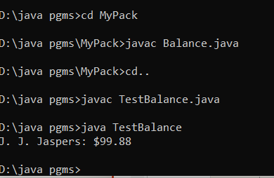
Importing Packages

Slide 30
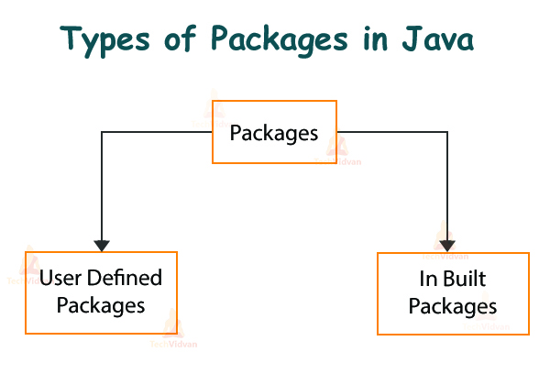
Packages
Types of Packages in Java
They can be divided into two categories:
Java API packages or built-in packages and
User-defined packages.

Slide 31
Packages
Java provides a large number of classes grouped into different packages based on a particular functionality.
Examples:
java.lang: It contains classes for primitive types, strings, math functions, threads, and exceptions.
java.util: It contains classes such as vectors, hash tables, dates, Calendars, etc.
java.io: It has stream classes for Input/Output.
java.awt: Classes for implementing Graphical User Interface – windows, buttons, menus, etc.
java.net: Classes for networking
java. Applet: Classes for creating and implementing applets

Slide 32
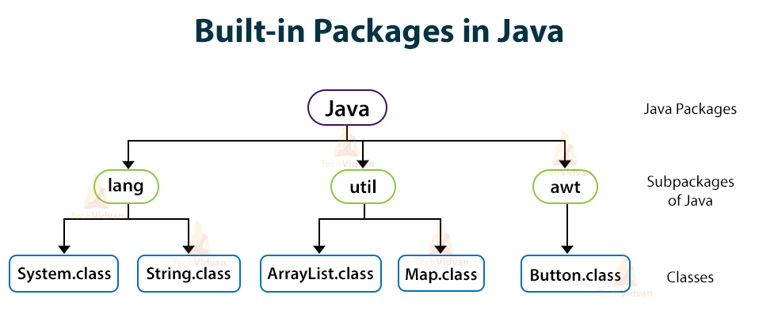
Packages

Slide 33
Advantages of Packages
Programmers can define their own packages to bundle a group of classes/interfaces, etc.
It is a good practice to group related classes implemented by you so that a programmer can easily determine that the classes, interfaces, enumerations, and annotations are related.
Since the package creates a new namespace there won't be any name conflicts with names in other packages.
Make easy searching or locating of classes and interfaces.
Avoid naming conflicts. For example, there can be two classes with the name Student in two packages, university.csdept.Student and college.itdept.Student
Implement data encapsulation (or data-hiding).
Provide controlled access: The access specifiers protected and default have access control on package level. A member declared as protected is accessible by classes within the same package and its subclasses. A member without any access specifier that is default specifier is accessible only by classes in the same package.
Reuse the classes contained in the packages of other programs.
Uniquely compare the classes in other packages.

Slide 34
EXCEPTION
An exception (or exceptional event) is a problem that arises during the execution of a program. When an Exception occurs the normal flow of the program is disrupted and the program/Application terminates abnormally, which is not recommended, Therefore, these exceptions are to be handled.
An exception can occur for many different reasons.
Following are some scenarios where an exception occurs.
A user has entered an invalid data.
A file that needs to be opened cannot be found.
A network connection has been lost in the middle of communications or the JVM has run out of memory.
Some of these exceptions are caused by user error, others by programmer error, and others by physical resources that have failed in some manner.

Slide 35
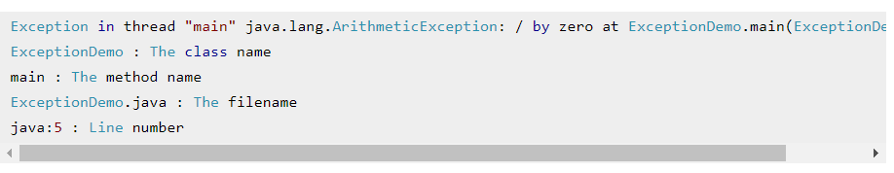
EXCEPTION
If an exception occurs, which has not been handled by programmer then program execution gets terminated and a system generated error message is shown to the user. For example look at the system generated exception below
An exception generated by the system is given below

Slide 36
EXCEPTION HANDLING
This message is not user friendly so a user will not be able to understand what went wrong.
In order to let them know the reason in simple language, we handle exceptions.
We handle such conditions and then prints a user friendly warning message to user, which lets them correct the error as most of the time exception occurs due to bad data provided by user.

Slide 37
EXCEPTION HANDLING
An exception is an abnormal condition that arises in a code sequence at run time.
In other words, an exception is a run-time error.
In computer languages that do not support exception handling, errors must be checked and handled manually—typically through the use of error codes, and so on.
This approach is as cumbersome as it is troublesome.
Java’s exception handling avoids these problems and, in the process, brings run-time error management into the object oriented world.

Slide 38
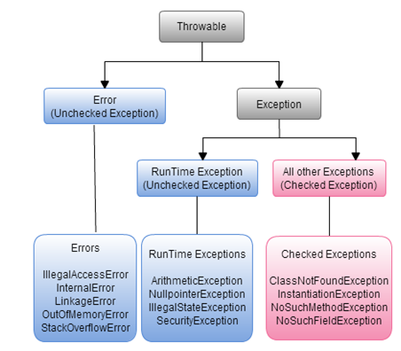
EXCEPTION CLASS HIERARCHY

Slide 39
Exception-Handling Fundamentals
Java exception handling is managed via five keywords:
try
catch
throw
throws
finally

Slide 40
Exception-Handling Fundamentals
Program statements that you want to monitor for exceptions are contained within a try block.
If an exception occurs within the try block, it is thrown.
Your code can catch this exception (using catch) and handle it in some rational manner.
System-generated exceptions are automatically thrown by the Java run-time system.
To manually throw an exception, use the keyword throw.
Any exception that is thrown out of a method must be specified as such by a throws clause.
Any code that absolutely must be executed after a try block completes is put in a finally block.

Slide 41
Exception-Handling Fundamentals
This is the general form of an exception-handling block:
try {
// block of code to monitor for errors
}
catch (ExceptionType1 exOb) {
// exception handler for ExceptionType1
}
catch (ExceptionType2 exOb) {
// exception handler for ExceptionType2
}

Slide 42
Exception-Handling Fundamentals
// ...
finally {
// block of code to be executed after try block ends
}
Here, ExceptionType is the type of exception that has occurred.

Slide 43
Exception-Handling Fundamentals
// ...
finally {
// block of code to be executed after try block ends
}
Here, ExceptionType is the type of exception that has occurred.

Slide 44
TYPES OF EXCEPTION
All exception types are subclasses of the built-in class Throwable.
Thus, Throwable is at the top of the exception class hierarchy.
Immediately below Throwable are two subclasses that partition exceptions into two distinct branches.
One branch is headed by Exception. This class is used for exceptional conditions that user programs should catch.
This is also the class that you will subclass to create your own custom exception types.
There is an important subclass of Exception, called RuntimeException.
Exceptions of this type are automatically defined for the programs that you write and include things such as division by zero and invalid array indexing.

Slide 45
TYPES OF EXCEPTION
The other branch is topped by Error, which defines exceptions that are not expected to be caught under normal circumstances by your program.
Exceptions of type Error are used by the Java run-time system to indicate errors having to do with the run-time environment,itself.
Stack overflow is an example of such an error.[The common cause for a stack overflow is a bad recursive call. ]
Errors are typically created in response to catastrophic failures that cannot usually be handled by your program.

Slide 46
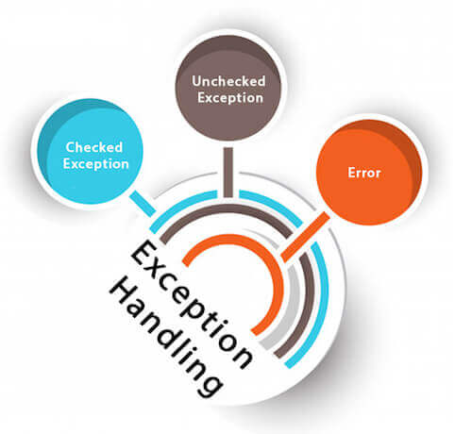
TYPES OF EXCEPTION
Checked Exception
Unchecked Exception
Error

Slide 47
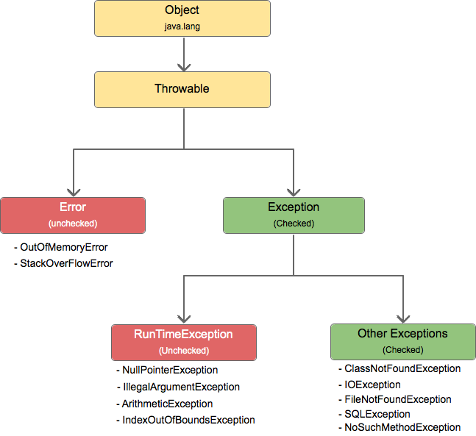
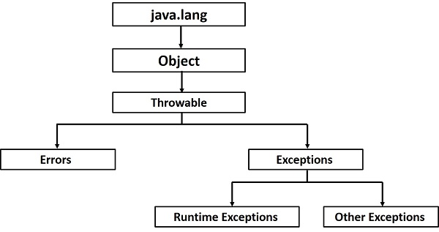
EXCEPTION CLASS HIERARCHY

Slide 48
CHECKED EXCEPTION
A checked exception is an exception that occurs at the compile time, these are also called as compile-time exceptions.
These exceptions cannot simply be ignored at the time of compilation; the programmer should take care of (handle) these exceptions.
When a checked/compile time exception occurs you can resume the program by handling it using try-catch blocks or we should declare the exception using throws keyword, otherwise the program will give a compilation error.
Using these you can display your own message or display the exception message after the execution of the complete program.

Slide 49
CHECKED EXCEPTION
The classes which directly inherit Throwable class except RuntimeException and Error are known as checked exceptions
e.g. IOException, SQL Exception
IOException is related to Input and Output operations in the Java code. This exception happens when there is a failure during reading, writing and searching file or directory operations. IOException is a checked exception. A checked exception is handled in the java code by the developer.
IOException has sub classes such as FileNotFoundException, EOFException, UnsupportedEncodingException, SocketException, and SSLException

Slide 50
Checked Exception Example
import java.io.*; class Example { public static void main(String args[]) { FileInputStream fis = null; *This constructor FileInputStream(File filename) * throws FileNotFoundException which is a checked * exception */ fis = new FileInputStream("B:/myfile.txt"); int k; | while(( k = fis.read() ) != -1) { System.out.print((char)k); } /*The method close() closes the file input stream * It throws IOException*/ fis.close(); } }

Slide 51
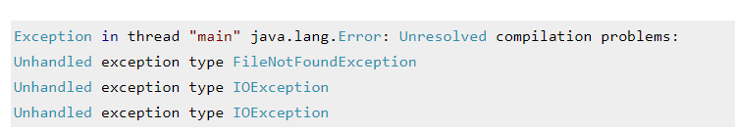
Checked Exception Example -output

Slide 52
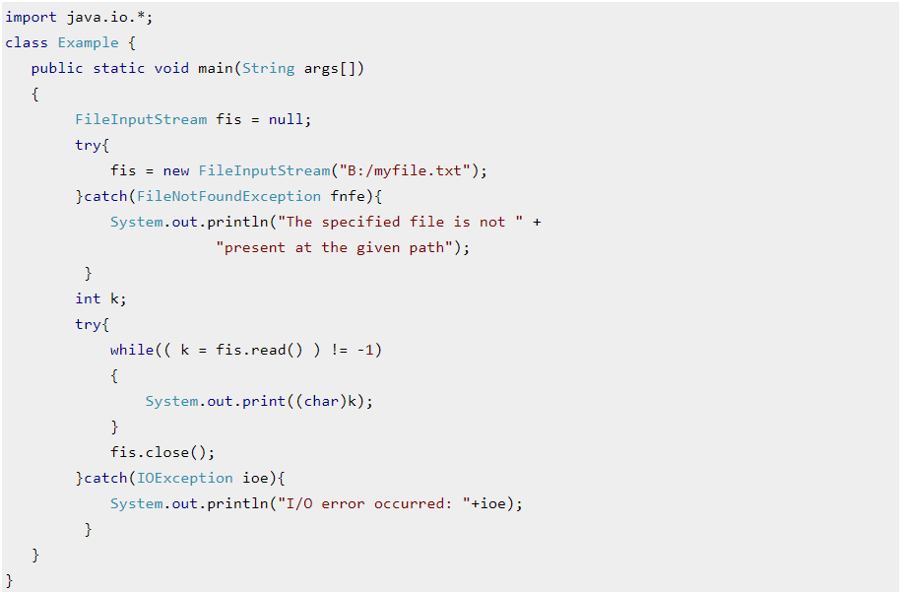
How to resolve the error?

Slide 53
Unchecked exceptions[Run time exception]
Unchecked exceptions are not checked at compile time.
It means if your program is throwing an unchecked exception and even if you didn’t handle/declare that exception, the program won’t give a compilation error.
Most of the times these exception occurs due to the bad data provided by user during the user-program interaction.
It is up to the programmer to judge the conditions in advance, that can cause such exceptions and handle them appropriately.
All Unchecked exceptions are direct sub classes of RuntimeException class.

Slide 54
Unchecked exceptions
NullPointerException
ArrayIndexOutOfBoundsException
ArithmeticException
IllegalArgumentException
NumberFormatException

Slide 55
Unchecked Exception Example
class Exc0 {
public static void main(String args[]) {
int d = 0;
int a = 42 / d;
}
}
java.lang.ArithmeticException: / by zero
at Exc0.main(Exc0.java:4)

Slide 56
Unchecked Exception Example
When the Java run-time system detects the attempt to divide by zero, it constructs a new exception object and then throws this exception.
This causes the execution of Exc0 to stop, because once an exception has been thrown, it must be caught by an exception handler and dealt with immediately.
In this example, we haven’t supplied any exception handlers of our own, so the exception is caught by the default handler provided by the Java run-time system.
Any exception that is not caught by your program will ultimately be processed by the default handler.
The default handler displays a string describing the exception, prints a stack trace from the point at which the exception occurred, and terminates the program

Slide 57
Unchecked Exception –arithmetic exception Example
class Example {
public static void main(String args[])
{
int num1=10;
int num2=0;
/*Since I'm dividing an integer with 0 it should throw ArithmeticException */
int res=num1/num2;
System.out.println(res);
}
}

Slide 58
Unchecked Exception –ArrayIndexOutOfBoundsExceptionExample
class Example {
public static void main(String args[])
{
int arr[] ={1,2,3,4,5};
/* My array has only 5 elements but we are trying to display the value of 8th element. It should throw
* ArrayIndexOutOfBoundsException */
System.out.println(arr[7]);
}
}

Slide 59
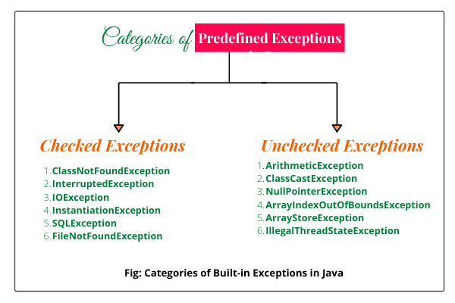
TYPES OF EXCEPTION
Checked Exception

Slide 60
Using try and catch
Although the default exception handler provided by the Java run-time system is useful for debugging, you will usually want to handle an exception yourself. Doing so provides two benefits.
First, it allows you to fix the error.
Second, it prevents the program from automatically terminating.
To guard against and handle a run-time error, simply enclose the code that you want to monitor inside a try block.
Immediately following the try block, include a catch clause that specifies the exception type that you wish to catch.

Slide 61
Using try and catch
class Exc2 {
public static void main(String args[]) {
int d, a;
try { // monitor a block of code.
d = 0;
a = 42 / d;
System.out.println("This will not be printed.");
}
catch (ArithmeticException e) { // catch divide-by-zero error
System.out.println("Division by zero.");
}
System.out.println("After catch statement.");
}
}

Slide 62
Using try and catch
This program generates the following output:
Division by zero.
After catch statement.
Notice that the call to println( ) inside the try block is never executed. Once an exception is thrown, program control transfers out of the try block into the catch block.
Put differently,catch is not “called,” so execution never “returns” to the try block from a catch. Thus, the line “This will not be printed.” is not displayed.
Once the catch statement has executed,program control continues with the next line in the program following the entire try/catch mechanism.

Slide 63
Using try and catch
A try and its catch statement form a unit.
The scope of the catch clause is restricted to those statements specified by the immediately preceding try statement.
The statements that are protected by try must be surrounded by curly braces.
You cannot use try on a single statement.
The goal of most well-constructed catch clauses should be to resolve the exceptional condition and then continue on as if the error had never happened.

Slide 64
Using try and catch
// Handle an exception and move on. import java.util.Random; class HandleError { public static void main(String args[]) { int a=0, b=0, c=0; Random r = new Random(); for(int i=0; i<32000; i++) { try { b = r.nextInt(); c = r.nextInt(); a = 12345 / (b/c); } | catch (ArithmeticException e) { System.out.println("Division by zero."); a = 0; // set a to zero and continue } System.out.println("a: " + a); } } }

Slide 65
Multiple catch Clauses
In some cases, more than one exception could be raised by a single piece of code.
To handle this type of situation, you can specify two or more catch clauses, each
catching a different type of exception.
When an exception is thrown, each catch statement is inspected in order, and the first one whose type matches that of the exception is executed.
After one catch statement executes, the others are bypassed, and execution continues after the try/catch block.
The following example traps two different exception types:

Slide 66
Using try and catch
// Demonstrate multiple catch statements. class MultiCatch { public static void main(String args[]) { try { int a = args.length; System.out.println("a = " + a); int b = 42 / a; int c[] = { 1 }; | c[42] = 99; } catch(ArithmeticException e) { System.out.println("Divide by 0: " + e); } catch(ArrayIndexOutOfBoundsException e) { System.out.println("Array index oob: " + e); } System.out.println("After try/catch blocks."); }}

Slide 67
Multiple catch Clauses
C:\>java MultiCatch
a = 0
Divide by 0: java.lang.ArithmeticException: / by zero
After try/catch blocks.
C:\>java MultiCatch TestArg
a = 1
Array index oob: java.lang.ArrayIndexOutOfBoundsException:42
After try/catch blocks.

Slide 68
public class MultipleCatchBlock2
{
public static void main(String[] args)
{
try{
int a[]=new int[5];
System.out.println(a[10]);
}
catch(ArithmeticException e)
{
System.out.println("Arithmetic Exception occurs"); }
catch(ArrayIndexOutOfBoundsException e)
{
System.out.println("ArrayIndexOutOfBounds Exception occurs");
}
catch(Exception e)
{ System.out.println("Parent Exception occurs");
}
System.out.println("rest of the code");
}
}

Slide 69
Multiple catch Clauses
When you use multiple catch statements, it is important to remember that exception subclasses must come before any of their superclasses.
This is because a catch statement that uses a superclass will catch exceptions of that type plus any of its subclasses.
Thus, a subclass would never be reached if it came after its superclass.

Slide 70
Nested try Statements
The try statement can be nested.
That is, a try statement can be inside the block of another try.
Each time a try statement is entered, the context of that exception is pushed on the stack.
If an inner try statement does not have a catch handler for a particular exception, the stack is unwound and the next try statement’s catch handlers are inspected for a match.
This continues until one of the catch statements succeeds, or until all of the nested try statements are exhausted.
If no catch statement matches, then the Java run-time system will handle the exception.

Slide 71
Using try and catch
// An example of nested try statements. class NestTry { public static void main(String args[]) { try { int a = args.length; /* If no command-line args are present, the following statement will generate a divide-by-zero exception. */ int b = 42 / a; | System.out.println("a = " + a); try { // nested try block /* If one command-line arg is used, then a divide-by-zero exception will be generated by the following code. */ if(a==1) a = a/(a-a); // division by zero /* If two command-line args are used, then generate an out-of-bounds exception. */ if(a==2) { int c[] = { 1 };

Slide 72
Using try and catch
c[42] = 99; // generate an out-of-bounds exception } } catch(ArrayIndexOutOfBoundsException e) { System.out.println("Array index out-of-bounds: " + e); } } catch(ArithmeticException e) { System.out.println("Divide by 0: " + e); }}}

Slide 73
Nested try Statements
When you execute the program with no command-line arguments, a divide-by-zero exception is generated by the outer try block.
Execution of the program with one command-line argument generates a divide-by-zero exception from within the nested try block.
Since the inner block does not catch this exception, it is passed on to the outer try block, where it is handled.
If you execute the program with two command-line arguments, an array boundary exception is generated from within the inner try block.
Here are sample runs that illustrate each case:

Slide 74
Nested try Statements
C:\>java NestTry
Divide by 0: java.lang.ArithmeticException: / by zero
C:\>java NestTry One
a = 1
Divide by 0: java.lang.ArithmeticException: / by zero
C:\>java NestTry One Two
a = 2
Array index out-of-bounds:
java.lang.ArrayIndexOutOfBoundsException:42

Slide 75
Difference between error and exception
Error : An Error “indicates serious problems that a reasonable application should not try to catch.”
Both Errors and Exceptions are the subclasses of java.lang.Throwable class.
Errors are the conditions which cannot get recovered by any handling techniques.
It surely cause termination of the program abnormally.
Errors belong to unchecked type and mostly occur at runtime.
Some of the examples of errors are Out of memory error or a System crash error.

Slide 76
Difference between error and exception
Exceptions : An Exception “indicates conditions that a reasonable application might want to catch.”
Exceptions are the conditions that occur at runtime and may cause the termination of program.
But they are recoverable using try, catch and throw keywords.
Exceptions are divided into two catagories : checked and unchecked exceptions.
Checked exceptions like IOException known to the compiler at compile time while
Unchecked exceptions like ArrayIndexOutOfBoundException known to the compiler at runtime.
It is mostly caused by the program written by the programmer.

Slide 77
Advantage of exception handling
Exception handling ensures that the flow of the program doesn’t break when an exception occurs.
For example, if a program has bunch of statements and an exception occurs mid way after executing certain statements then the statements after the exception will not execute and the program will terminate abruptly.
Separating Error Handling Code from "Regular" Code :In traditional programming, error detection, reporting, and handling often lead to confusing spaghetti code. Java provides an elegant solution to the problem of error management: exceptions. Exceptions enable you to write the main flow of your code and deal with the, well, exceptional cases elsewhere.

Slide 78
Advantage of exception handling
Propagating Errors Up the Call Stack :A second advantage of exceptions is the ability to propagate error reporting up the call stack of methods.
Grouping Error Types and Error Differentiation

Slide 79
Java throw keyword
The Java throw keyword is used to throw an exception explicitly.
We specify the exception object which is to be thrown.
The Exception has some message with it that provides the error description.
These exceptions may be related to user inputs, server, etc.
We can throw either checked or unchecked exceptions in Java by throw keyword.
It is mainly used to throw a custom exception

Slide 80
We can also define our own set of conditions and throw an exception explicitly using throw keyword.
For example, we can throw Arithmetic Exception if we divide a number by another number. Here, we just need to set the condition and throw exception using throw keyword.
The syntax of the Java throw keyword is given below.
throw Instance i.e.,
throw new exception_class("error message");
Example : throw new IOException("sorry device error");

Slide 81
public class TestThrow1 {
//function to check if person is eligible to vote or not
public static void validate(int age) {
if(age<18) {
//throw Arithmetic exception if not eligible to vote
throw new ArithmeticException("Person is not eligible to vote");
}
else {
System.out.println("Person is eligible to vote!!");
} }
//main method
public static void main(String args[]){
//calling the function
validate(13);
System.out.println("rest of the code...");
}
}

Slide 82
FINALLY
finally creates a block of code that will be executed after a try/catch block has completed and before the code following the try/catch block.
The finally block will execute whether or not an exception is thrown.
If an exception is thrown, the finally block will execute even if no catch statement matches the exception.
Any time a method is about to return to the caller from inside a try/catch block, via an uncaught exception or
an explicit return statement, the finally clause is also executed just before the method returns.
This can be useful for closing file handles and freeing up any other resources that might have been allocated at the beginning of a method with the intent of disposing of them before returning.
The finally clause is optional. However, each try statement requires at least one catch or a finally clause.

Slide 83
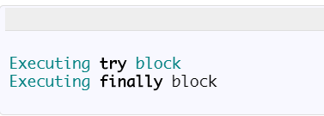
FINALLY
We can have try without catch block by using finally block.
You can use try with finally. As you know finally block always executes even if you have exception or return statement in try block except in case of System.exit().
public class TryWithoutCatchMain {
public static void main(String args[])
{
try
{
System.out.println("Executing try block");
}
finally
{
System.out.println("Executing finally block");
} }}
.

Slide 84
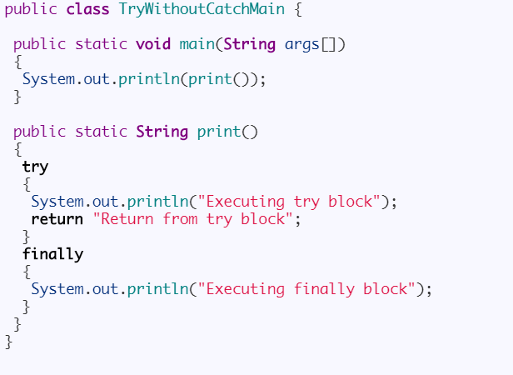
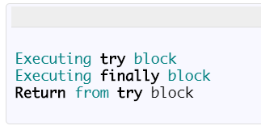
What happens when you have return statement in try block:
.

Slide 85
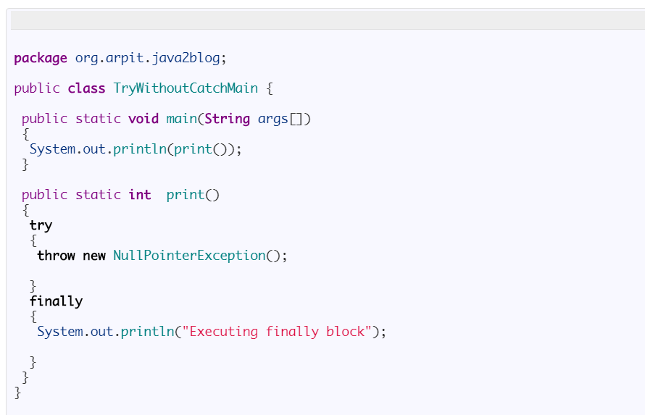
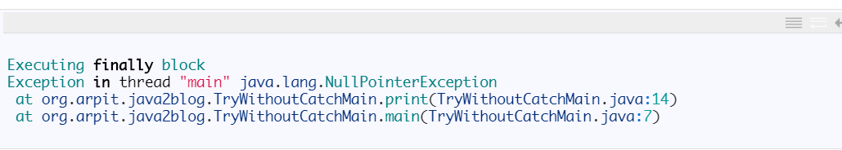
What if exception is thrown in try block :
.

Slide 86
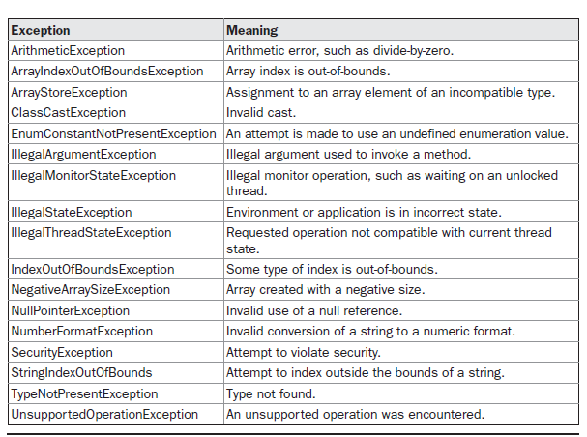
Java’s Built-in Exceptions [Java’s Unchecked Runtime Exception Subclasses Defined in java.lang]
.

Slide 87
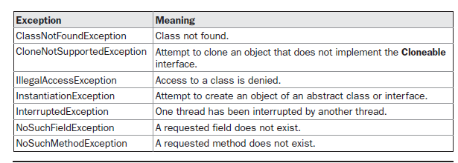
Java’s Built-in Exceptions [Java’s Checked Exceptions Defined in java.lang]
.

Slide 88
Creating Your Own Exception Subclasses [USER DEFINED EXCEPTIONS]
Just define a subclass of Exception.
The Exception class does not define any methods of its own.
It does, of course, inherit those methods provided by Throwable.
Thus, all exceptions, including those that you create,have the methods defined by Throwable available to them.
Override one or more of these methods in exception classes that you create.
CONSTRUCTORS OF EXCEPTION CLASS
Exception( )
Exception(String msg)
You can override toString( ).
The version of toString( ) defined by Throwable (and inherited by Exception) first displays the name of the exception followed by a colon, which is then followed by your description.
By overriding toString( ), you can prevent the exception name and colon from being displayed..

Slide 89
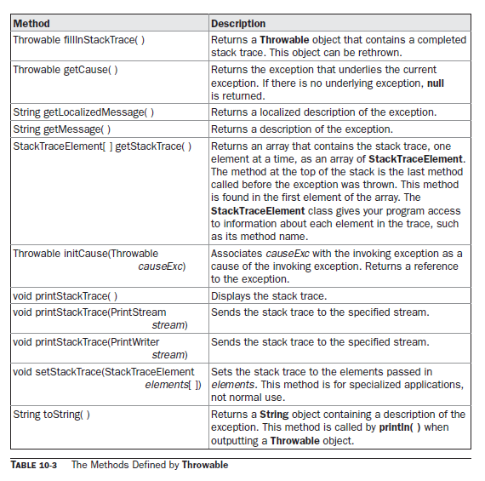
Creating Your Own Exception Subclasses [USER DEFINED EXCEPTIONS]

Slide 90
Creating Your Own Exception Subclasses [USER DEFINED EXCEPTIONS]
// This program creates a custom exception type. class MyException extends Exception { private int detail; MyException(int a) { detail = a; } public String toString() { return "MyException[" + detail + "]"; }} class ExceptionDemo { static void compute(int a) throws MyException { System.out.println("Called compute(" + a + ")"); | if(a > 10) throw new MyException(a); System.out.println("Normal exit"); } public static void main(String args[]) { try { compute(1); compute(20); } catch (MyException e) { System.out.println("Caught " + e); } } }

Slide 91
Java Throws Keyword
The throws keyword in Java is used to declare exceptions that can occur during the execution of a program
For any method that can throw exceptions, it is mandatory to use the throws keyword to list the exceptions that can be thrown.
The throws keyword provides information about the exceptions to the programmer as well as to the caller of the method that throws the exceptions.
The throws keyword allows exceptions to be propagated in the call stack.

Slide 92
When a method declares that it throws an exception, it is not required to handle the exception.
The caller of a method that throws exceptions is required to handle the exceptions (or throw them to its caller and so on) so that the flow of the program can be maintained.
Only checked exceptions are required to be thrown using the throws keyword. Unchecked exceptions don’t need to be thrown or handled explicitly in code.

Slide 93
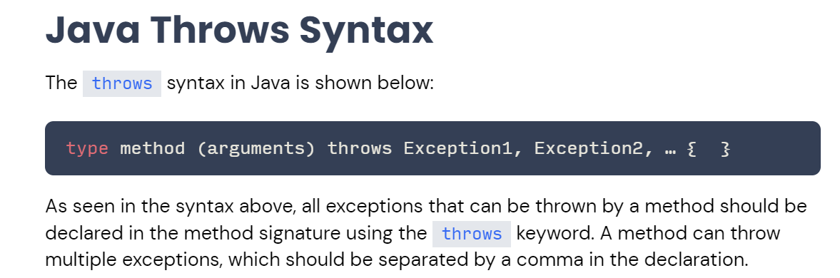

Slide 94
public class Main {
static void checkAge(int age) throws ArithmeticException {
if (age < 18) {
throw new ArithmeticException("Access denied - You must be at least 18 years old.");
}
else {
System.out.println("Access granted - You are old enough!");
}
}
public static void main(String[] args) {
checkAge(15); // Set age to 15 (which is below 18...)
}
}

Slide 95
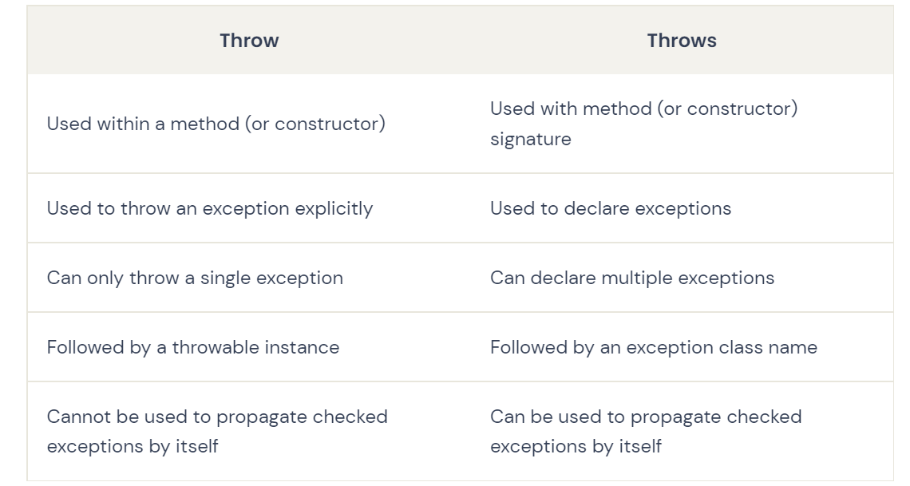

Slide 96
throwS
throws is a keyword in Java which is used in the signature of method to indicate that this method might throw one of the listed type exceptions.
The caller to these methods has to handle the exception using a try-catch block.
To prevent compile time error we can handle the exception in two ways:
By using try catch
By using throws keyword
We can use throws keyword to delegate the responsibility of exception handling to the caller (It may be a method or JVM) then caller method is responsible to handle that exception.

Slide 97
throwS
import java.io.*;
class M{
void method()throws IOException{
throw new IOException("device error");
}
}
public class Testthrows2{
public static void main(String args[]){
try{
M m=new M();
m.method();
}catch(Exception e){System.out.println("exception handled");}
System.out.println("normal flow...");
}
}

Slide 98
throwS
A throws clause lists the types of exceptions that a method might throw.
We can use throws keyword to delegate the responsibility of exception handling to the caller (It may be a method or JVM) then caller method is responsible to handle that exception.
It gives an information to the programmer that there may occur an exception so it is better for the programmer to provide the exception handling code so that normal flow can be maintained.
This is the general form of a method declaration that includes a throws clause:
type method-name(parameter-list) throws exception-list
{
// body of method
}
Here, exception-list is a comma-separated list of the exceptions that a method can throw.

Slide 99
What is the need of having throws keyword when you can handle exception using try-catch?
The throws does the same thing that try-catch does but there are some cases where you would prefer throws over try-catch. For example: Lets say we have a method myMethod() that has statements that can throw either ArithmeticException or NullPointerException, in this case you can use try-catch as shown below:
public void myMethod()
{ try {
// Statements that might throw an exception
}
catch (ArithmeticException e) {
// Exception handling statements
}
catch (NullPointerException e) {
// Exception handling statements
} }

Slide 100
What is the need of having throws keyword when you can handle exception using try-catch?
But suppose you have several such methods that can cause exceptions, in that case it would be tedious to write these try-catch for each method.
The code will become unnecessary long and will be less-readable.
One way to overcome this problem is by using throws like this: declare the exceptions in the method signature using throws and handle the exceptions where you are calling this method by using try-catch.
Another advantage of using this approach is that you will be forced to handle the exception when you call this method, all the exceptions that are declared using throws, must be handled where you are calling this method else you will get compilation error.

Slide 101
What is the need of having throws keyword when you can handle exception using try-catch?
public void myMethod() throws ArithmeticException, NullPointerException
{
// Statements that might throw an exception
}
public static void main(String args[]) {
try {
myMethod();
}
catch (ArithmeticException e) {
// Exception handling statements
}
catch (NullPointerException e) {
// Exception handling statements
}
}

Slide 102
Creating Your Own Exception Subclasses [USER DEFINED EXCEPTIONS]
The ExceptionDemo class defines a method named compute( ) that throws a MyException object.
The exception is thrown when compute( )’s integer parameter is greater than 10.
The main( ) method sets up an exception handler for MyException, then calls compute( ) with a legal value (less than 10) and an illegal one to show both paths through the code. Here is the result:
Called compute(1)
Normal exit
Called compute(20)
Caught MyException[20]

Slide 103
Creating Your Own Exception Subclasses [USER DEFINED EXCEPTIONS]
The ExceptionDemo class defines a method named compute( ) that throws a MyException object.
The exception is thrown when compute( )’s integer parameter is greater than 10.
The main( ) method sets up an exception handler for MyException, then calls compute( ) with a legal value (less than 10) and an illegal one to show both paths through the code. Here is the result:
Called compute(1)
Normal exit
Called compute(20)
Caught MyException[20]

Slide 104
SUMMARY
Exception handling provides a powerful mechanism for controlling complex programs that have many dynamic run-time characteristics.
It is important to think of try, throw, and catch as clean ways to handle errors and unusual boundary conditions in your program’s logic.
Unlike some other languages in which error return codes are used to indicate failure, Java uses exceptions.
Thus, when a method can fail, have it throw an exception. This is a cleaner way to handle failure modes.
One last point: Java’s exception-handling statements should not be considered a general mechanism for nonlocal branching. If you do so, it will only confuse your code and make it hard to maintain.

